Slide 1
Engage Teens through Hybrid College Fairs
Joe Holder & Brian Pappas
School Liaison Officers
Stuttgart, Germany

Slide 2
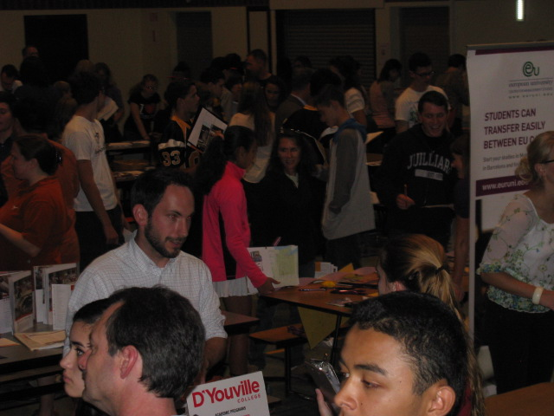
Stuttgart College Fair 2014
7 Virtual Colleges
12 Organizations
67 Colleges/Universities represented
92 Students logged onto collegeweeklive.com
563 participants

Slide 3
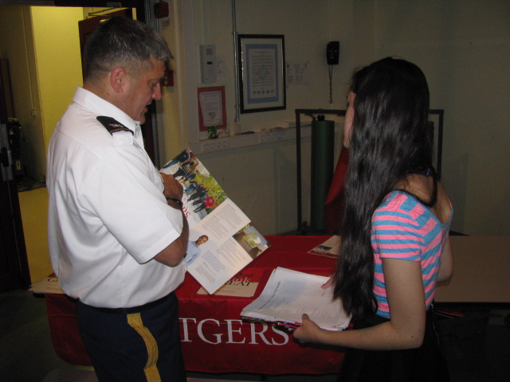
Connecting Kids with Colleges
Benefits of Hybrid Fair
Partnering with Staff, School, Students
Leveraging Community Resources
Promoting the Hybrid Fair

Slide 4
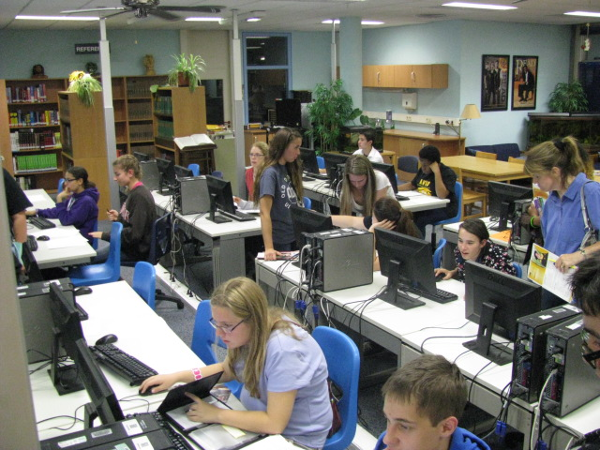
Benefits
Connecting students and colleges
Targeting specific schools
Building relationships

Slide 5
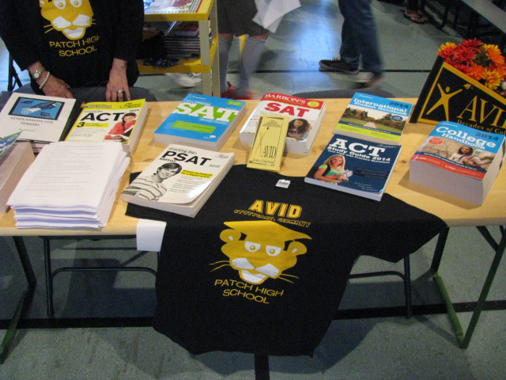
Partnering
Understanding relationships
Engaging key players
Facilitating communication flow
Meeting and exceeding expectations

Slide 6
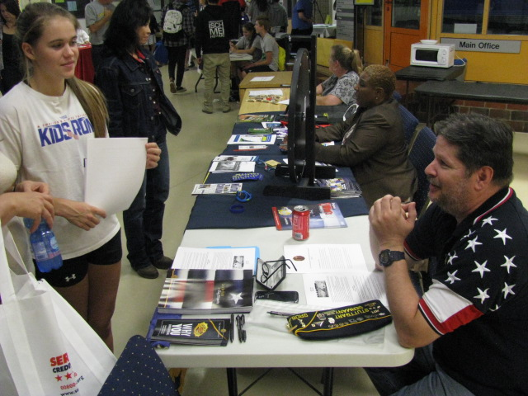
Community Resources
Engaging community
Strengthening relationships
Empowering students

Slide 7
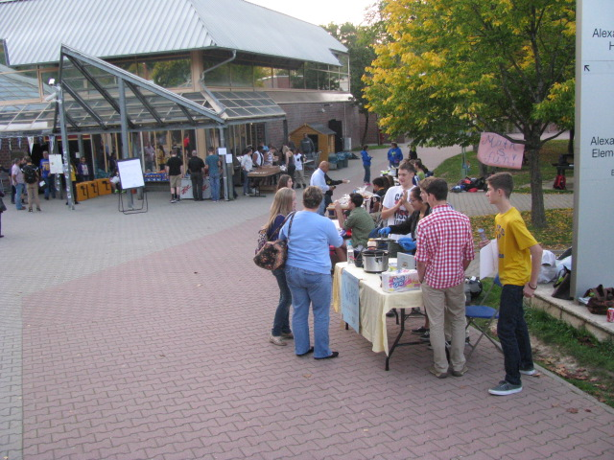
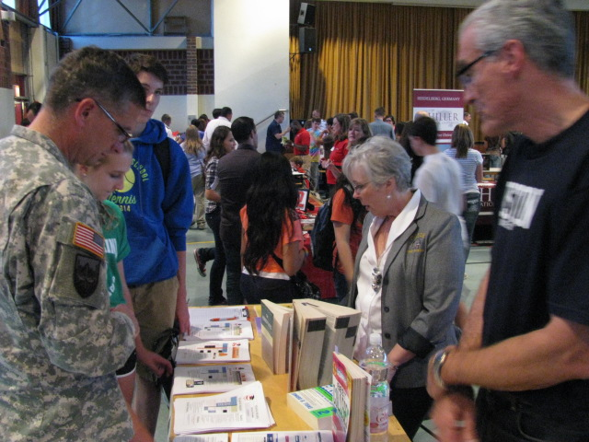
Promotion
Targeting your audiences
Managing your resources

Slide 8
QUESTIONS?

